Slide 1
CHAPTER 2
REVIEW OF THE LINEAR REGRESSION MODEL
2.1 Conditional Density and Conditional Moments
Table 2.1 Sample Conditional and Unconditional Moments of Consumption
Income ($000) | 20 | 40 | 60 | 80 | 100
 | 19 | 25 | 44 | 55 | 55
 | 15 | 32 | 35 | 60 | 77
 | 11 | 37 | 55 | 75 | 88
 | 13 | 19 | 57 | 45 | 42
Consumption ($000) | 9 | 20 | 58 | 68 | 82
 | 8 | 32 | 59 | 73 | 90
 | 18 | 31 | 42 | 71 | 77
 | 16 | 38 | 38 | 49 | 67
 | 12 | 18 | 33 | 56 | 60
 | 11 | 26 | 47 | 71 | 43
Conditional mean of Consumption | 13.2 | 27.8 | 46.8 | 62.3 | 68.1
Conditional standard deviation of consumption | 3.70 | 7.29 | 9.90 | 10.71 | 17.56
Unconditional mean of consumption = $43.6
Unconditional st. dev of consumption = $23.31
González-Rivera: Forecasting for Economics and Business,
Copyright © 2013 Pearson Education, Inc.

Slide 2
Figure 2.1 Conditional Density and Conditional Moments
Conditional variance:
Var(consumption | income=60K)
Conditional density:
f(consumption | income=60K)
consumption
Conditional mean:
E(consumption | income=40K)
40K
60K
income
González-Rivera: Forecasting for Economics and Business, Copyright © 2013 Pearson Education, Inc.

Slide 3











2.2 Linear Regression Model
Figure 2.2 Population Linear Regression Model
González-Rivera: Forecasting for Economics and Business, Copyright © 2013 Pearson Education, Inc.

Slide 4
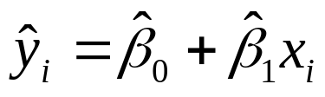







2.3 Estimation: Ordinary Least Squares
Figure 2.3 Sample Linear Regression Model
González-Rivera: Forecasting for Economics and Business, Copyright © 2013 Pearson Education, Inc.

Slide 5
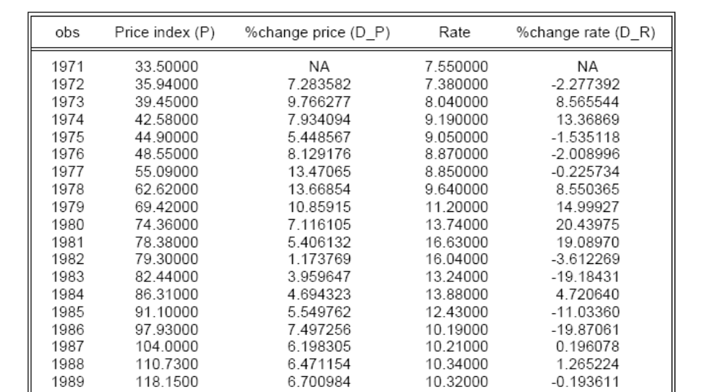
2.3.4 An Example: House Prices and Interest Rates
Table 2.2 House Prices and Interest Rates. Multiple Regression: The Data
(1) (2) (3) (4) (5)
González-Rivera: Forecasting for Economics and Business, Copyright © 2013 Pearson Education, Inc.

Slide 6
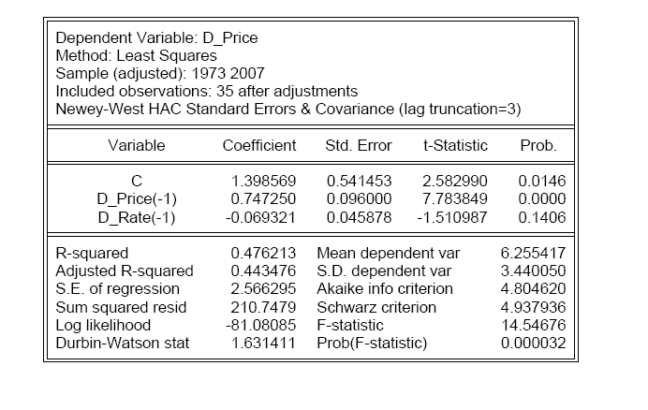



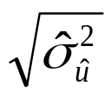
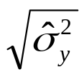
Table 2.3 House Prices and Interest Rates. Multiple Regression: OLS estimation
Robust
SSR
F-test for overall significance of the regression
González-Rivera: Forecasting for Economics and Business, Copyright © 2013 Pearson Education, Inc.

Slide 7
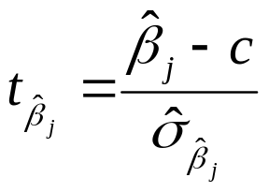
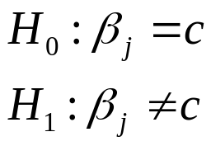
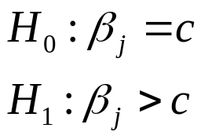






2.4 Hypothesis Testing in a Regression Model
Figure 2.4 Rejection Rules for the t-ratio
Two-sided alternative hypothesis
One-sided alternative hypothesis
Acceptance region
Acceptance region
Rejection region
Rejection region
Rejection region
0
0
González-Rivera: Forecasting for Economics and Business, Copyright © 2013 Pearson Education, Inc.

Slide 8
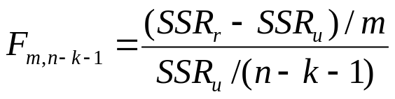


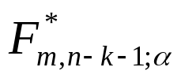
Figure 2.5 Rejection Rules for the F-ratio
Acceptance region
Rejection region
0
González-Rivera: Forecasting for Economics and Business, Copyright © 2013 Pearson Education, Inc.

